Slide 1
Determining sample size: some practical guidelines
Tony Panzarella,
Assistant Professor,
Division of Biostatistics,
Dalla Lana School of Public Health
CHL5207Y / CHL5208Y

Slide 2
The most common question you’ll get in your career is…
“How large a sample size do I need to run my study?”
CHL5207Y / CHL5208Y

Slide 3
The best answer…
”It depends”
CHL5207Y / CHL5208Y

Slide 4
Learning Objectives
To identify parameters required for a sample size calculation and to understand their inter-relationship
How to illicit the required parameter information from a researcher
Options when the sample size is small
CHL5207Y / CHL5208Y

Slide 5
Learning Objectives
Identify common mistakes when undertaking a sample size calculation
Post-hoc power is inappropriate
CHL5207Y / CHL5208Y

Slide 6
Study Planning
Good study planning has many aspects. For example,
  Unambiguous study question
  Proper selection of sample
  Reliable measurement instruments
  Adequate sample size
CHL5207Y / CHL5208Y

Slide 7
Sample size balancing act
Needs to be large enough to detect a clinically important difference as statistically significant
But, not so big as to detect as statistically significant an effect of little scientific importance
CHL5207Y / CHL5208Y

Slide 8
Poor planning ramifications
Cost
  Under-sized - waste of resources
  Over-sized - uses more resources than necessary
CHL5207Y / CHL5208Y

Slide 9
Poor planning ramifications
Ethics
  Under-sized exposes patients to potentially harmful treatments without advancing knowledge
  In an over-sized study an unnecessary number of subjects are exposed to a potentially harmful treatment, or are denied a potentially useful one.
CHL5207Y / CHL5208Y

Slide 10
Sample size approaches
Precision approach – specify desired width of a confidence interval
Bayesian approach – optimize a utility function (precision and cost)
Power of a hypothesis test
CHL5207Y / CHL5208Y

Slide 11
Power
Give me more power!
CHL5207Y / CHL5208Y

Slide 12

Power approach
CHL5207Y / CHL5208Y

Slide 13
Power elements
Specify a hypothesis test
Specify the significance level σ of the test
Specify an effect size Δ that reflects an alternative of scientific interest
Obtain other parameter estimates
Specify target value of power of test
CHL5207Y / CHL5208Y

Slide 14
Question
Generally, which type of error, I or II, is more serious, and why?
CHL5207Y / CHL5208Y

Slide 15
Statistical Hypothesis Testing
Decision | H_{o} is really true i.e., there is really no effect to find | H_{o} is really false i.e., there really is an effect to be found
Retain H_{o} | correct decision: prob = 1 - α | Type II error: prob = β
Reject H_{o} | Type I error: prob = α | correct decision: prob = 1 - β
Power

Slide 16
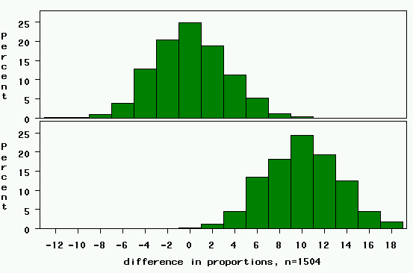
study 1: 263 cases, 1241 controls
Rejection region. Any value >= 6.5 (0+3.3*1.96)
Null Distribution: difference=0.
For 5% significance level, one-tail area=2.5%
(Z_{α/2} = 1.96)
Power= chance of being in the rejection region if the alternative is true=area to the right of this line (in yellow)→
Clinically relevant alternative: difference=10%.

Slide 17
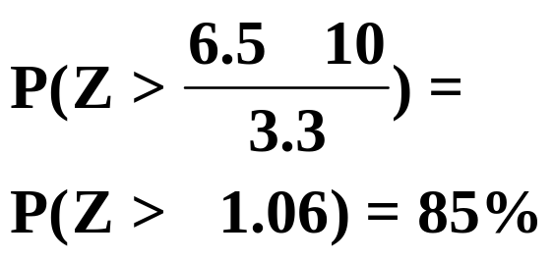
study 1: 263 cases, 1241 controls
Rejection region. Any value >= 6.5 (0+3.3*1.96)
Power= chance of being in the rejection region if the alternative is true=area to the right of this line (in yellow)
Power here:

Slide 18
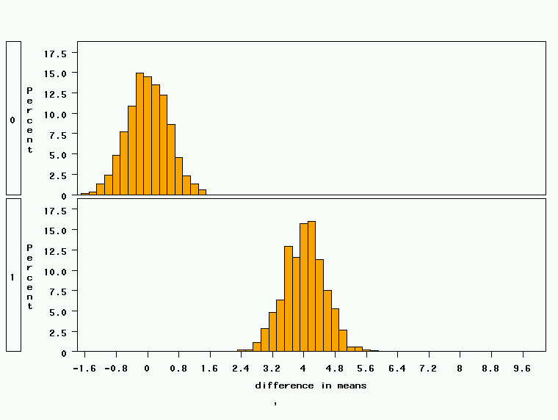
Study 2: 18 treated, 72 controls, STD DEV = 2
Critical value= 0+0.52*1.96 = 1
Clinically relevant alternative: difference=4 points
Power is nearly 100%!

Slide 19
Factors Affecting Power
1. Size of the effect
2. Standard deviation of the characteristic
3. Bigger sample size
4. Significance level desired
Notes:
It turns out that if you were to go out and sample many, many times, most sample statistics that you could calculate would follow a normal distribution.
What are the 2 parameters (from last time) that define any normal distribution?
Remember that a normal curve is characterized by two parameters, a mean and a variability (SD)
What do you think the mean value of a sample statistic would be? The standard deviation?
Remember standard deviation is natural variability of the population
Standard error can be standard error of the mean or standard error of the odds ratio or standard error of the difference of 2 means, etc. The standard error of any sample statistic.

Slide 20
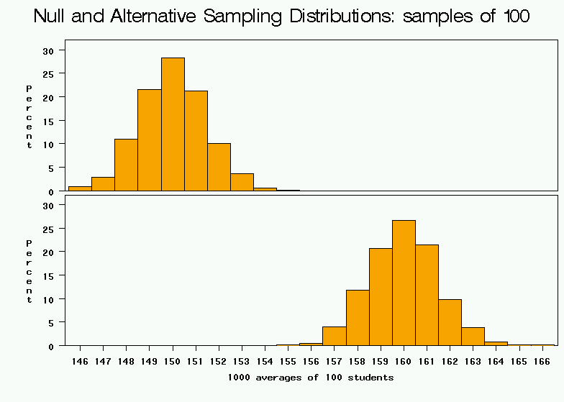
1. Bigger difference from the null mean
Null
Clinically relevant alternative
average weight from samples of 100

Slide 21
2. Bigger standard deviation
average weight from samples of 100

Slide 22
3. Bigger Sample Size
average weight from samples of 100

Slide 23
4. Higher significance level
Rejection region.
average weight from samples of 100

Slide 24
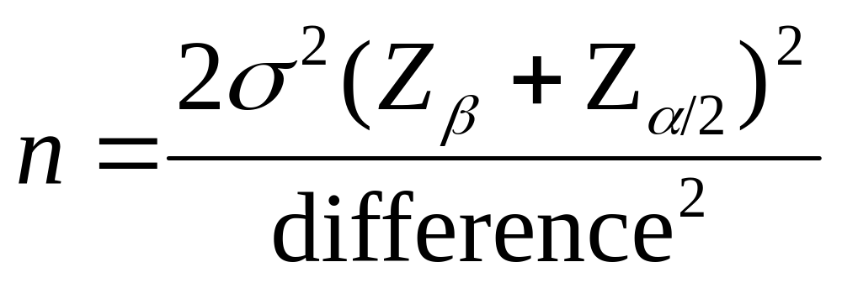
Simple formula for difference in means
Represents the desired power (typically .84 for 80% power).
Sample size in each group (assumes equal sized groups)
Represents the desired level of statistical significance (typically 1.96).
Standard deviation of the outcome variable
Effect Size (the difference in means)

Slide 25
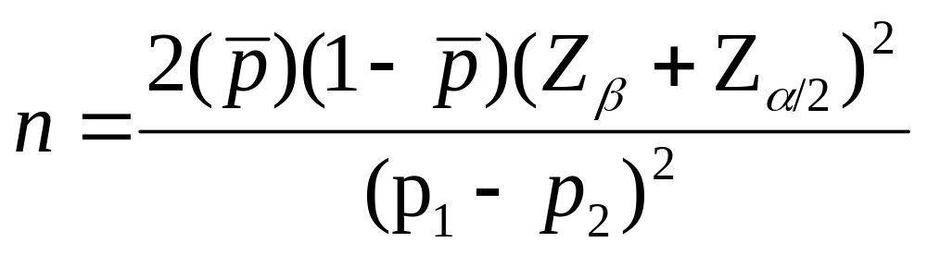
Simple formula for difference in proportions
Represents the desired power (typically .84 for 80% power).
Sample size in each group (assumes equal sized groups)
Represents the desired level of statistical significance (typically 1.96).
A measure of variability (similar to standard deviation)
Effect Size (the difference in proportions)

Slide 26
Example 1
Two-sample experiment comparing treatment and control
Response: Systolic blood pressure (SBP) using a sphygmomanometer
1-sided test as treatment supposed to reduce SBP
CHL5207Y / CHL5208Y

Slide 27
Goal
Detect an improvement of 15 mm Hg for the treatment group with 80% power when the significance level is 0.05
Historical data suggests the data to be Normally distributed with SD = 20 mm Hg
Test to be used: two-sample t test
CHL5207Y / CHL5208Y

Slide 28

Rollin Brant's Home Page
Rollin Brant
Professor
Department of Statistics
Quick Links
Bayesian Adaptive Trials
Sample Size Calculators
STATA QuickStart
CHL5207Y / CHL5208Y

Slide 29
Resources
Web sample size calculators
  South West Oncology Group
Commercial software e.g.
  PASS
  Power and Precision
  nQuery Advisor
  SAS
CHL5207Y / CHL5208Y

Slide 30
SAS solution – let’s calculate it
RUN 1st PROC POWER in SAS PROGRAM
proc power;
twosamplemeans
meandiff = 15
stddev = 20
groupweights = (1 1)
alpha = 0.05
sides = 1
power = 0.85
ntotal = .;
run;
CHL5207Y / CHL5208Y

Slide 31
What is usually taught
Define formal hypotheses
Significance level
CHL5207Y / CHL5208Y

Slide 32
What is usually taught
Target power. 0.80 minimal?
As power increases sample size increases at an increasing rate
In our example requesting power of 0.95 increases sample size per group by 75%
CHL5207Y / CHL5208Y

Slide 33
What is usually NOT taught
Effect size determination
Parameter estimates not involved in the hypotheses
Where did the 15 mm Hg effect size and SD=20 mm Hg come from?
CHL5207Y / CHL5208Y

Slide 34
Effect size
It is not the job of the statistician to decide this
It is the job of the statistician to get this information from the PI’s
Researchers often don’t know what is being asked of them – lost in statistical jargon
CHL5207Y / CHL5208Y

Slide 35
Example 1
H0: µ_{T} = µ_{C} versus H1: µ_{T} < µ_{C}
where µ_{T} is the mean SBP for treatment and µ_{C} is the mean SBP for control
The effect being tested is the difference µ_{T} - µ_{C}
CHL5207Y / CHL5208Y

Slide 36
Effect size exchange
Statistician
“How big a difference would be important for you to be able to detect with 90% power using a Student’s t test with α = 0.05?”
Clinician
“Huh??” or “you’re the statistician – what do you recommend?” or “Any difference at all would be important”
CHL5207Y / CHL5208Y

Slide 37
Biostatistics vs. Lab Research
https://www.youtube.com/watch?v=PbODigCZqL8
CHL5207Y / CHL5208Y

Slide 38
A better approach
Statistician: “What results do you expect (or hope to see)?”
Answer could be considered an upper bound
Statistician: “Would an effect of half that magnitude (but give the number) be of scientific interest?”
N should be calculated for various scenarios
CHL5207Y / CHL5208Y

Slide 39
A better approach
It may be helpful to focus on relative as opposed to absolute differences
It may be effective to reverse the context to what cannot be detected: “What is the range of clinical indifference?”
CHL5207Y / CHL5208Y

Slide 40
A better approach
“If you were the patient, would the benefits of reducing SBP by 15 mm Hg outweigh the cost, inconvenience, and potential side effects of this treatment?”
Ask directly for an upper bound on sample size (Boen and Zahn (1982))
CHL5207Y / CHL5208Y

Slide 41
Tradeoff
Sample size vs. effect size
Requires the technical skills of the statistician and the scientific knowledge of the researcher
CHL5207Y / CHL5208Y

Slide 42
Finding the right variance
Power functions usually involve parameters unrelated to the hypotheses. Where to obtain?
  Researcher experience (ask for histogram)
  Data from the literature (like with like?)
    Careful thought about all sources of variation
  Conduct a pilot study
CHL5207Y / CHL5208Y

Slide 43
What if you’re told of the N to use
Budget
Convention
If N is fixed focus on other parameters
  The effect size that will be detectable with a given power is…Then discuss the effect size
  Consider revising design to lower variation
CHL5207Y / CHL5208Y

Slide 44
Not all sample size problems are created equal
What are the consequences of getting it wrong?
Normally distributed data – relatively easy.
  Software
  Tables
  Nomograms
CHL5207Y / CHL5208Y

Slide 45
Not all sample sizes problems are created equal
Survival analysis data includes more parameters e.g. survival at 5 years in the control group, treatment group, accrual time, follow-up time.
Simulation may be required for mathematically intractable problems
CHL5207Y / CHL5208Y

Slide 46
Three research strategies
CHL5207Y / CHL5208Y

Slide 47

Nike approach
CHL5207Y / CHL5208Y

Slide 48


Nike approach
Nike approach
Get an idea
“Just do it!”
Small, negative trial
Small, negative trial
Small, negative trial
Meta analysis
CHL5207Y / CHL5208Y

Slide 49

Spider-man approach
CHL5207Y / CHL5208Y

Slide 50

Spider-man approach
Get an idea
Estimate sample size
TOO BIG!!!
Network with colleagues
Multi-centre Trial
Positive Result
CHL5207Y / CHL5208Y

Slide 51

Schwarzenegger
Approach
CHL5207Y / CHL5208Y

Slide 52
Schwarzenegger Approach
Get an idea
Estimate sample size
TOO BIG!!!
Terminate the project
Save time & money
CHL5207Y / CHL5208Y

Slide 53
Advice – things to avoid
Avoid “T-shirt” standardized or unit-free effect sizes as in (Cohen 1988)
  Small – 0.2
  Medium – 0.5
  Large – 0.8
Convenient way to avoid determining effect size and variance estimates
CHL5207Y / CHL5208Y

Slide 54
Common Mistakes
Related to Sample Size
Failure to discuss sample size or power in published papers (especially studies with negative results)
Unrealistic assumptions related to effect size
Failure to explore sample size
requirements for a range of possible values of key variables (sensitivity analysis)

Slide 55

Common Mistakes
Related to Sample Size (cont)
Treating Type I (<0.05) and Type II (<0.2) threshold error rates as if they were divinely inspired
Failure to account for attrition by boosting planned sample size

Slide 56
Advice – things to avoid
Avoid post-hoc power calculations
CHL5207Y / CHL5208Y

Slide 57
Post-hoc power
You've got the data, did the analysis, and did not achieve
"significance." So you compute power retrospectively to see if the
test was powerful enough or not. This is an empty question. Of
course it wasn't powerful enough -- that's why the result isn't
significant. Power calculations are useful for design, not analysis.
(Note: These comments refer to power computed based on the
observed effect size and sample size. Considering a different
sample size is obviously prospective in nature. Considering a
different effect size might make sense, but probably what you
really need to do instead is an equivalence test; see Hoenig and
Heisey, 2001.)
CHL5207Y / CHL5208Y

Slide 58
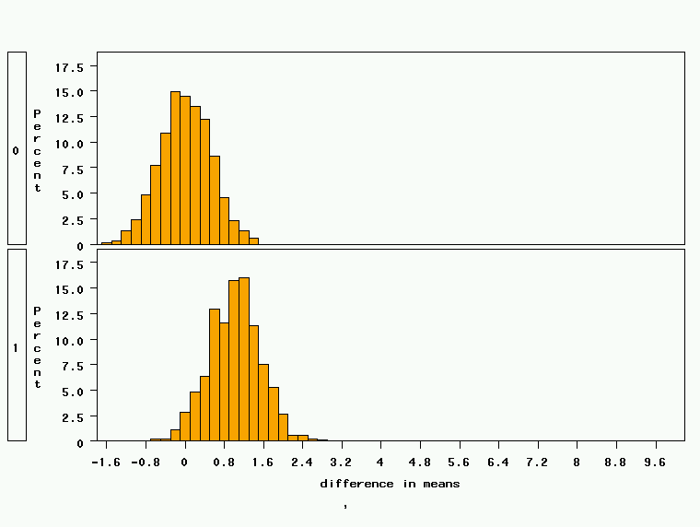
Study 2: 18 treated, 72 controls, effect size=1.0
Critical value= 0+0.52*1.96 = 1
Power is about 50%
Clinically relevant alternative: difference=1 point

Slide 59
Example 2
Medical treatment has a cure rate of 45%
Surgical procedure proposed – given morbidity a 70% cure rate sought to justify use
90% power to “detect” a 25% difference between 2 treatments with n=80 in each group
CHL5207Y / CHL5208Y

Slide 60
Example 2
We observed a cure rate of 60/80 (75%) in one group, 49/80 (61%) in the other
14% difference; P=0.06; 95% CI (-1% to 29%)
Power of observed difference is 45%
The study is not too small to detect a 14% difference!
CHL5207Y / CHL5208Y

Slide 61
Three very right things you can do
Use power prospectively for planning future studies.
CHL5207Y / CHL5208Y

Slide 62
Three very right things you can do
Put science before statistics
  The appropriate inputs to power/sample-size calculations are effect sizes that are deemed clinically important, based on careful considerations of the underlying scientific (not statistical) goals of the study. Statistical considerations are used to identify a plan that is effective in meeting scientific goals -- not the other way around.
CHL5207Y / CHL5208Y

Slide 63
Clinical Significance
A very large study has the power to demonstrate statistical significance for very small, even clinically inconsequential differences.
CHL5207Y / CHL5208Y

Slide 64
Clinical significance
“A difference to be a difference must make a difference”
  Gertrude Stein (1874-1946) American Writer in France
CHL5207Y / CHL5208Y

Slide 65
Three very right things you can do
Do pilot studies
  A pilot study helps you establish procedures, understand and protect against things that can go wrong, and obtain variance estimates needed in determining sample size. A pilot study with 20-30 degrees of freedom for error is generally quite adequate for obtaining reasonably reliable sample-size estimates.
CHL5207Y / CHL5208Y

Slide 66
How to Get By with a Smaller Sample
1. Double-check your assumptions:
  Type I (α) error rate (0.10 instead of 0.05?)
  Type II (β) error rate (0.30 instead of 0.20?)
2. Double-check your hypothesis:
  One-tailed instead of two-tailed?
3. Double-check your desired effect size:
  Is the intervention likely to have an effect of this size?
  Can I settle for being able to find a larger effect?

Slide 67
How to Get By with a Smaller Sample (cont)
4. Use a more frequent dichotomous outcome variable:
  Less serious outcome (don’t sacrifice clinical face validity)
  Composite outcome (watch for undesired heterogeneity)
  Lengthen follow-up period
  Select higher-risk study subjects

Slide 68
How to Get By with a Smaller Sample (cont)
5. To decrease variability (increase reliability) of continuous outcome measures, use:
  A continuous variable instead of a dichotomous variable, if possible, but don't give up clinical face validity to gain statistical power (e.g., mean birthweight).
  More precise, reliable equipment or data collection techniques; consider repeated/ multiple measurements.
  Paired (pre-post or matched) measurements to reduce variability; consider crossover design.

Slide 69
How to Get By with a Smaller Sample (cont)
6. Increase your sample size cheaply:
  Consider unequal group
  sizes (2–3 controls per case)
  to increase efficiency
  in a case-control study
7. Compromise or get more money

Slide 70
References
Lenth, RV. Some practical guidelines for effective sample-size determination http://www.stat.uiowa.edu/~rlenth/Power/ and http://www.stat.uiowa.edu/techrep/tr303.pdf
Boen JR and Zahn DA (1982) The Human side of statistical consulting, Lifetime learning publications, Belmont, CA.
Cohen J (1988) Statistical power Analysis for the Behavioral Sciences, Academic press, New York, 2nd ed.
Hahn P. Sample size estimation http://meds.queensu.ca/medicine/obgyn/scholar/Sample%20size%20estimation_p.pdf
Goodman SN and Berlin JA (1994) The use of predicted confidence intervals when planning experiments and the misuse of power when interpreting results Ann Intern Med; 121:200-206
CHL5207Y / CHL5208Y

Slide 71
A review
Type I and Type II error are inversely proportional?
  True
  False
CHL5207Y / CHL5208Y

Slide 72
A review
Which of the following statement is not true?
  The power of a non-significant difference will always be < 50%
  Sample size is inversely proportional to the effect size
  A power of 95% should always be preferred over a power of 90%.
CHL5207Y / CHL5208Y

Slide 73
A review
Why is it important to determine a sample size that detects the smallest clinically significant difference?
CHL5207Y / CHL5208Y

Slide 74
A review
If reporting post-hoc power is inappropriate once the study results are in what statistical tool is useful to summarize the reliability of the study finding?
CHL5207Y / CHL5208Y

